Slide 1
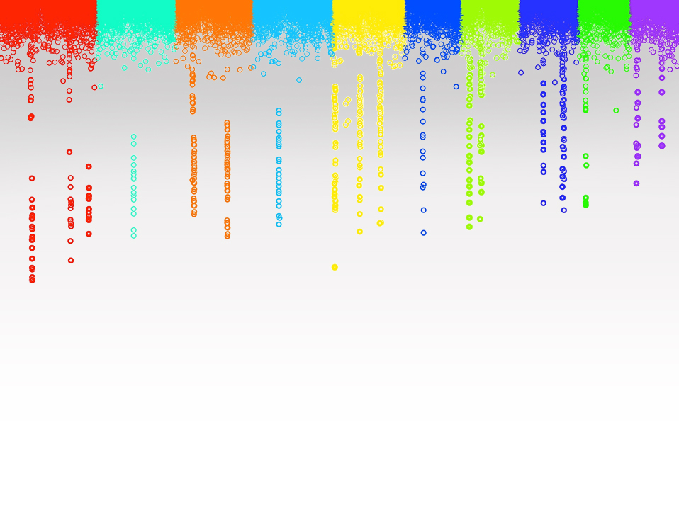

Statistical Genomics
Lecture 6: Genotype by sequencing
Zhiwu Zhang
Washington State University

Slide 2
Outline
Genetic markers
Sequencing
Full vs. reduced

Slide 3
Human genome project
Funded by DOE, NIH and Welcome Trust in the UK
Begun in 1990
Original planed to last 15 years.
Institute for Genomic Research and U. of Washington provided over 450K BAC each was tagged and contain 3~4 Kb across the entire human genome

Slide 4
Human genome project
Accelerate the completion date to 2003
Celera Genomics
Craig Venter was among those sequenced
Identified 20~120K genes
Sequence of 3 billion base pairs
Cost near 3 billion dollars

Slide 5
Types of genetic markers
RFLP: Restriction fragment length polymorphism
SSR: Simple Sequence Repeats
SNP: Single Nucleotide Polymorphism
Chip
Sequencing

Slide 6
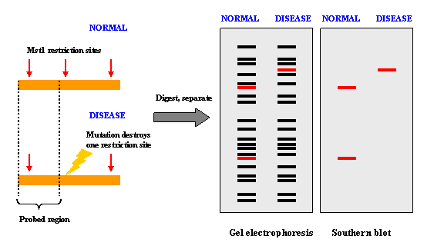
RFLP
Restriction Enzyme
Restriction fragment length polymorphism

Slide 7
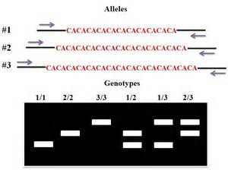
SSR

Slide 8
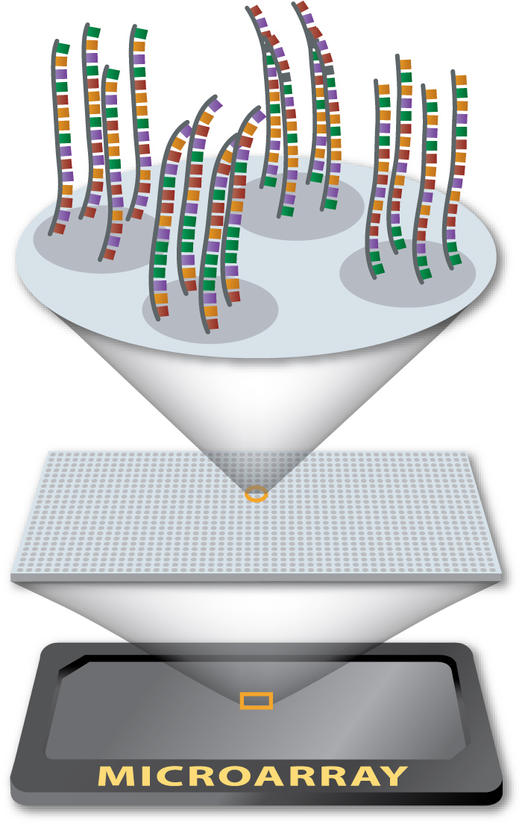
SNP by hybridization
http://www.genome.gov/10000533

Slide 9
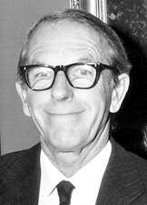
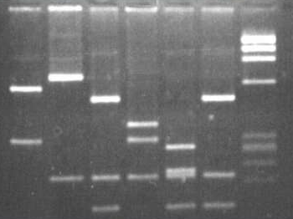
Fredric Sanger
1958 Nobel Price of Chemistry for Protein identification by electrophoresis
1980 Nobel Price of Chemistry for DNA sequencing

Slide 10
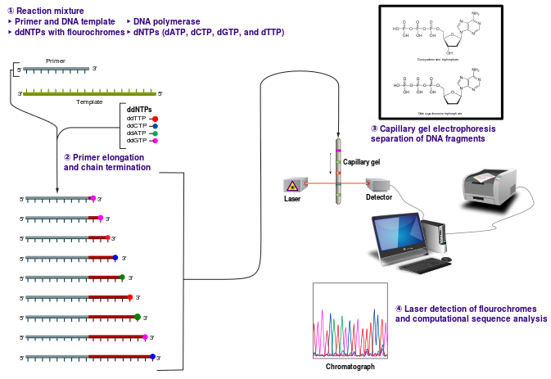
Ladder of DNA length
dNTP (deoxynucleotides)
ddNTP: (dideoxynucleotides): chain reaction terminator

Slide 11
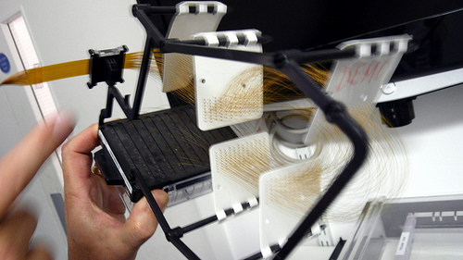
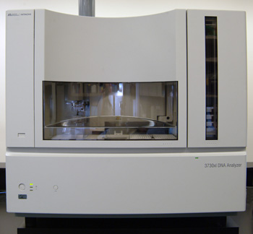
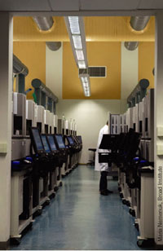
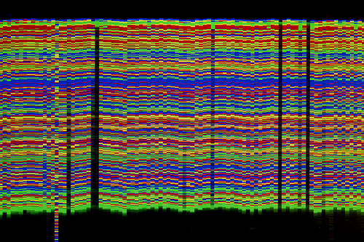
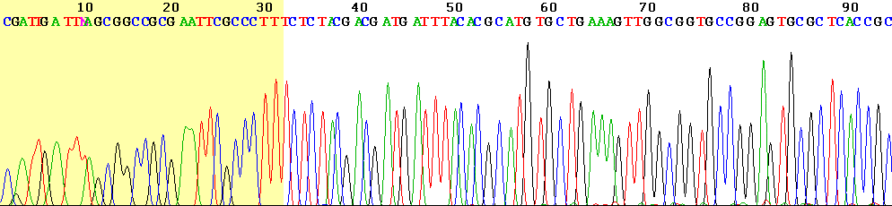
1st Generation DNA sequencing
Fred Sanger and Alan R. Coulson, Nature 24, 687–695 (1977)

Slide 12
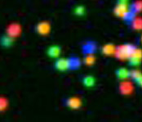
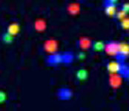
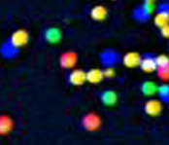
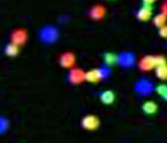
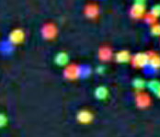
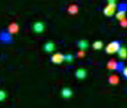
2nd generation sequencing
Sequencing-by-synthesis by 454 Life Science: Margulies, M. et al. Nature 437, 376–380 (2005).
Multiplex Polony sequencing by George M. Church lab at Harvard Medical School: Shendure, J. et al. Science 309, 1728–1732 (2005).
1
2
3
4
5
6

Slide 13
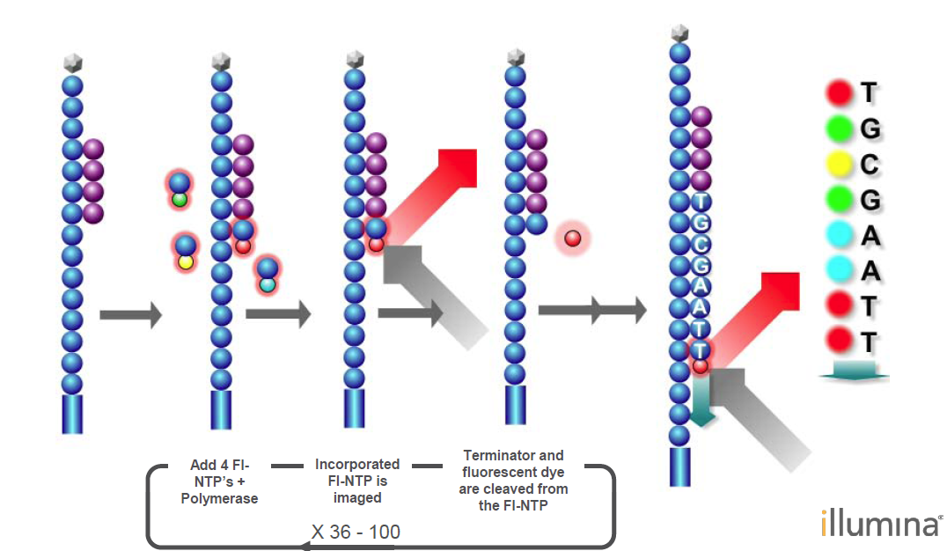
Sequencing-by-synthesis
454 Life Science: Margulies, M. et al. Nature 437, 376–380 (2005).
1
2
3
4
5
6
T G C T A C …
T T T T T T …
http://en.wikipedia.org/wiki/File:Sequencing_by_synthesis_Reversible_terminators.png

Slide 14
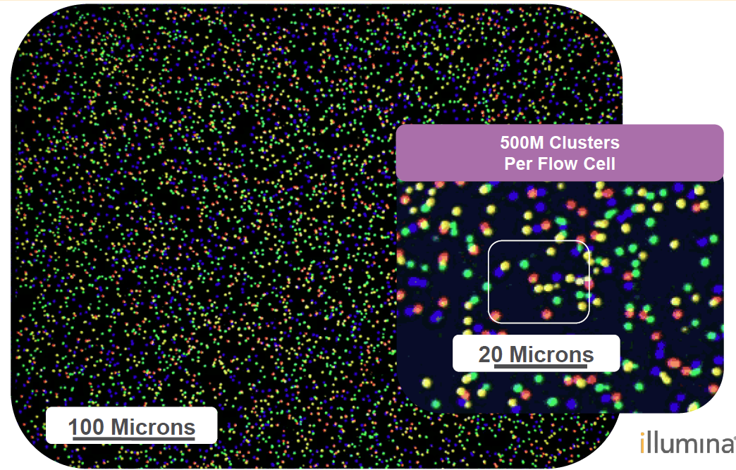

Slide 15
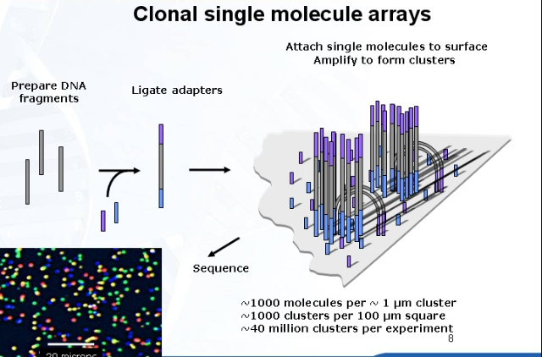
Multiplex Polony sequencing
George M. Church lab at Harvard Medical School: Shendure, J. et al. Science 309, 1728–1732 (2005).
http://wjingpan.blog.sohu.com/140002432.html

Slide 16
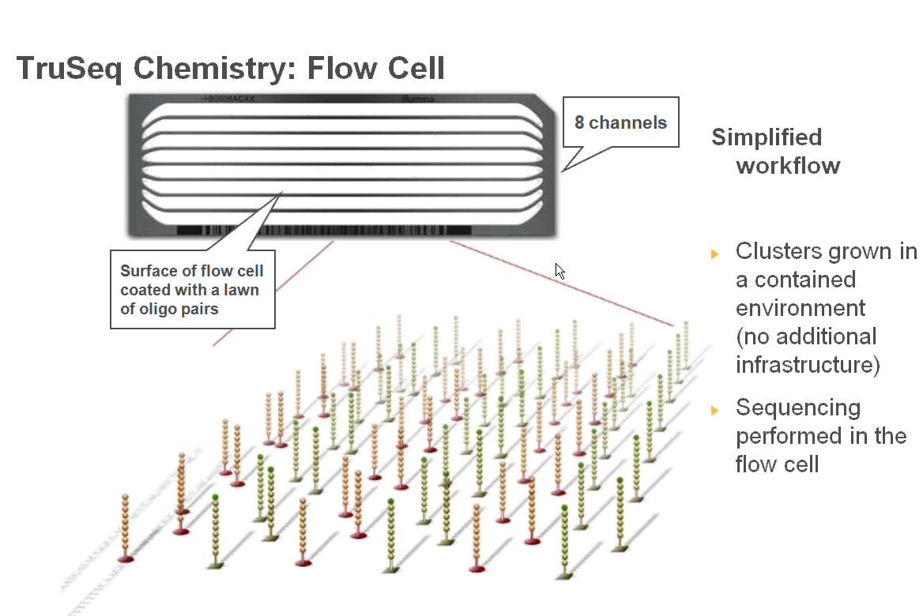

Slide 17
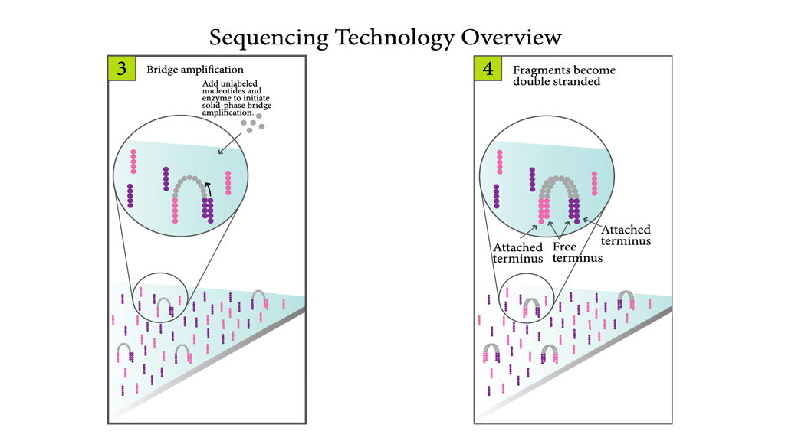
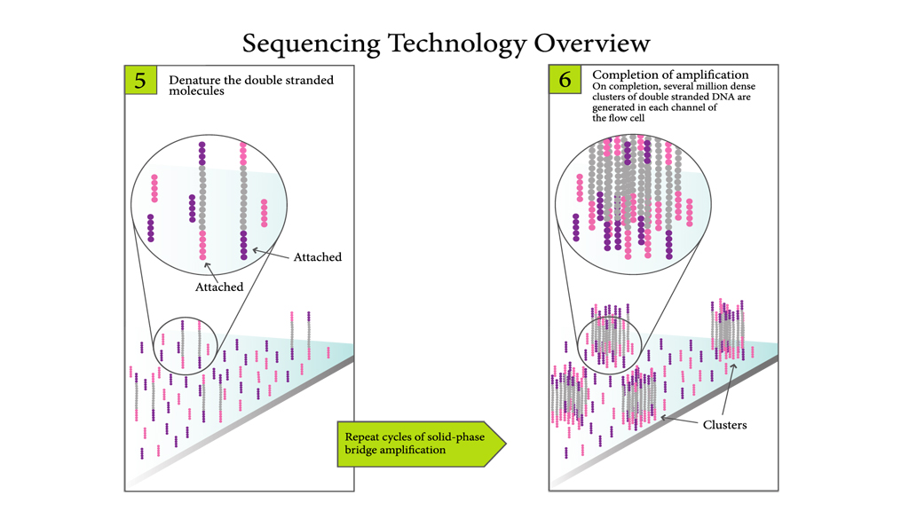
Cluster Generation

Slide 18
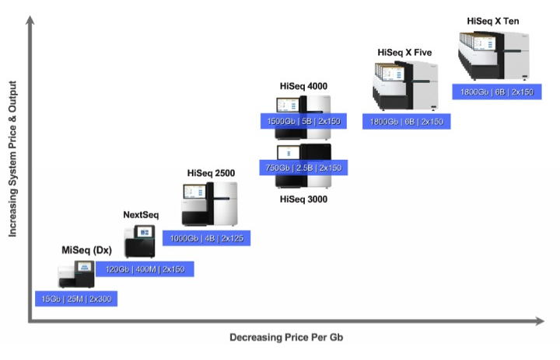
$1000 Genome
 | Price | Price/unit | $/Genome* | Consumables | $/Gb
HiSeq X Five | $6M | $1.2M | $1,425 | $1,200 | $10.6
HiSeq X Ten | $10M | $1M | $1,000 | $800 | $7
http://blog.genohub.com/illuminas-latest-release-hiseq-3000-4000-nextseq-550-and-hiseq-x5/

Slide 19
DNA/RNA fragmentation
Physical Fragmentation
1) Acoustic shearing
2) Sonication
3) Hydrodynamic shear
Enzymatic Methods
4) DNase I or other restriction endonuclease, non-specific nuclease
5) Transposase
Chemical Fragmentation
6) Heat and divalent metal cation

Slide 20
Reduced Genotyping Sequencing
Restriction site

Slide 21
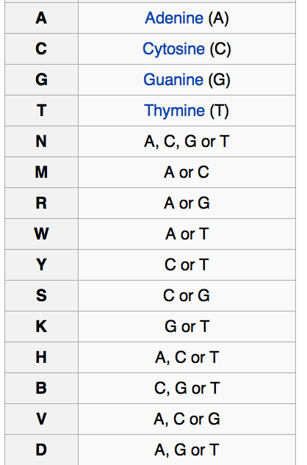
Restriction enzymes: ApeKI
Recognition: 5’GCWGC3’
W: A or T
Expected size:
4x4x2x4x4=512bp= 0.5Kb
Genome coverage
100 bp read/512 bp size=20%

Slide 22
Restriction enzymes: PstI
Recognition: 5’ CTGCAG3’
Expected size: 4^6=4096bp= 4Kb
Genome coverage
100 bp read/4096 bp size=2.5%

Slide 23
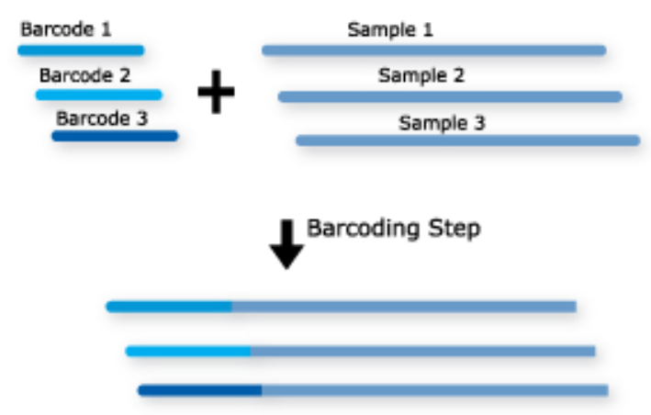
Multiplex barcode
Aalborg University, Denmark: Craig et al. Nat. Methods 2000, 5: 887–893.
4~8 bases

Slide 24
Adapter and Barcode
By Sharon Mitchell

Slide 25
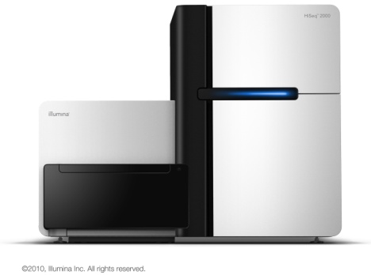
Genotyping by sequencing (GBS)
Digest DNA
Ligate adapters with barcodes
5. Illumina sequencing
3. Pool DNAs
4. PCR
.
.
.
.
.
.
.
.
.
.
.
.
.
.
.
.
.
.
.
.
.
.
.
.
.
.
.
.
.
.
.
.
.
.
.
.
.
.
.
.
.
.
.
.
.
.
.
.
.
.
.
.
.
.
.
.
.
.
.
.
.
.
.
.
.
.
.
.
.
.
.
.
.
.
.
.
.
.
.
.
.
.
.
.
.
.
.
.
.
.
.
.
.
.
.
.
.
.
.
.
.
.
.
.
.
.
.
.
.
.
.
.
.
.
.
.
.
.
.
.
.
.
.
.
.
.
.
.
.
.
.
.
.
.
.
.
.
.
.
.
.
.
.
.
.
.
.
Elshire et al. 2011. PLoS One
Notes:
Here, I need to make a brief introduction to genotyping by sequencing. This flowchart shows the protocol of GBS. The DNA samples are digested with enzyme and barcoded. Then we pool the DNA and do the PCR. Eventually the samples are sequenced in Illumina sequencer. This protocol is more simpler than the similar methods, like rrl and rad.

Slide 26
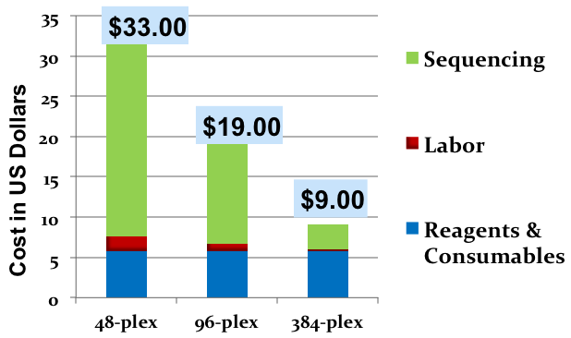
Cost reduction by multiplexing
Notes:
Besides, the GBS is cost effective. One sample only costs 9 dollors, if 384 plex is used. Considering the coverage, we used the 96 plex protocol on all the switchgrass samples.

Slide 27
Sequencing depth
Definition: Expected sequencing times per base pair
Calculation
100Mb genome, 100M read of 100 bp: 100X
3G genome, 1% reduced, 50 multiplex, 6G data (1byte one base): 6G/(50x3Gx1%)=4X

Slide 28
Genomic coverage and depth
 | ApeKI | PstI
Recognition bases | 5 | 6
Fragment size | .5Kb | 4Kb
Genome coverage (100bp read) | 20% | 2.5%
Number of unique sequence (3G genome) | 3G/.5Kb=6M | 3G/4Kb=.75M
Sequencing depth (60G data on 3G genome) | 60/(3x.2)=100X | 60/(3*.025)=800X

Slide 29
Distribution of length
Expectation of length=length/number of cut
Variance=Squared Expectation (need proof)

Slide 30
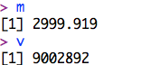
Distribution of length
n=100000
size=300000000
x=round(runif(n,1,size))
y=sort(x)
interval=y[-1]-y[-n]
hist(interval)
Ex=size/n
Va=Ex*Ex
m=mean(interval)
v=var(interval)
m
v

Slide 31
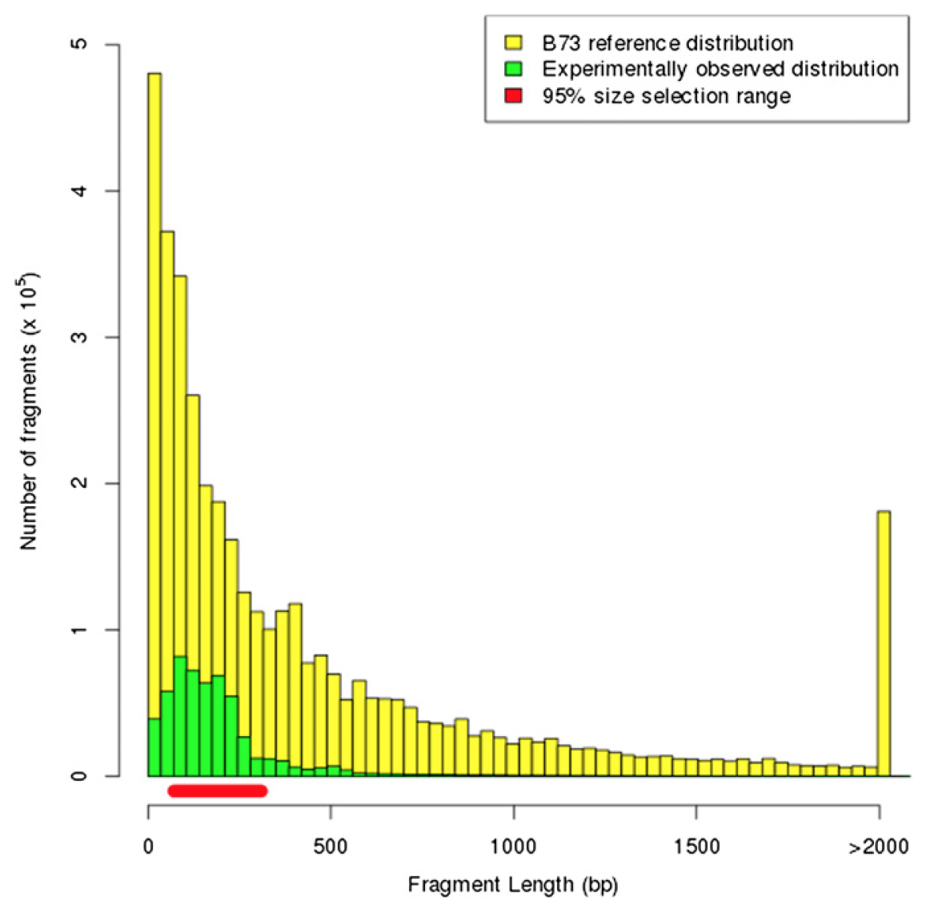
Distribution of length
Beissinger et al, Genetics.
2013, 193(4):1073-81

Slide 32
Outline
Genetic markers
Sequencing
Full vs. reduced
Experiment
Data process and format

